Slide 1
AUDify
Song recognition platform
Siddhant Attri (B18CSE052)
Sanskar Mani (B18CSE048)
Arushi Midha (B18BB006)
Vedanti Alaspure (B18EE054)
Divya Singh (B18EE014)

Slide 2
INTRODUCTION
AIM:
AUDify aims at identifying a song by analyzing its recorded audio segment, which would most likely be distorted due background noise and compressed, owing to the fact that the recording would be done using a tiny in-built microphone on a mobile phone.
Moreover, the algorithm targets to perform the recognition as fast as possible with a low number of false positives, that is, with the minimum scope of error in detection.
To successfully enable song recognition, we utilized the following processes in the same order as mentioned:
Sampling
Quantization
Discrete Fourier Transform using Fast Fourier Transform technique.
Matching Audio Fingerprints, which are extracted hash tokens from the audio samples, with the fingerprints of the songs present in our database and then the result was computed.

Slide 3
AUDIO FINGERPRINTING
Sampling and Quantization
For the audio to be analyzed and stored, it needs to be digitalized. Sampling of the signal is done, that is, converting it from continuous-time to discrete-time.
According to the Nyquist-Shannon theorem, for a sampled signal to be reconstructed, the sampling frequency should be greater than or equal to two times the frequency of the sampled signal. So, the sampling frequency was chosen as 22100 kHz, with the assumption that most songs do not contain frequencies greater than 10500 kHz.
To store the loudness which has an infinite variety of volume in a continuous signal to a discrete variation, quantization was done. The standard quantization is coded on 16 bits, which means 65536 levels.

Slide 4
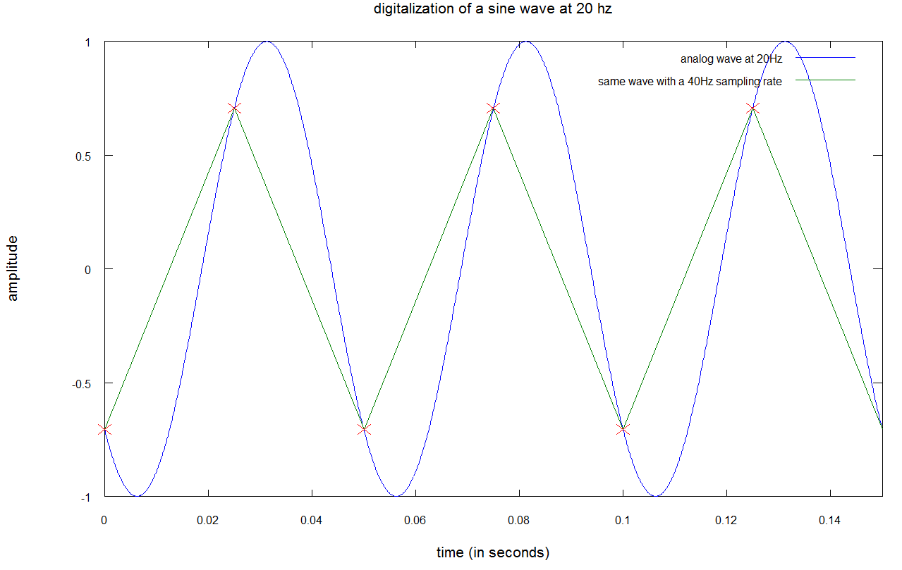
SAMPLING
the blue curve represents the sound at 20 Hz,
the red crosses represent the sampled sound, which means the blue curve is marked with a red cross every 1/40 second,
the green line an interpolation of the sampled sound.

Slide 5

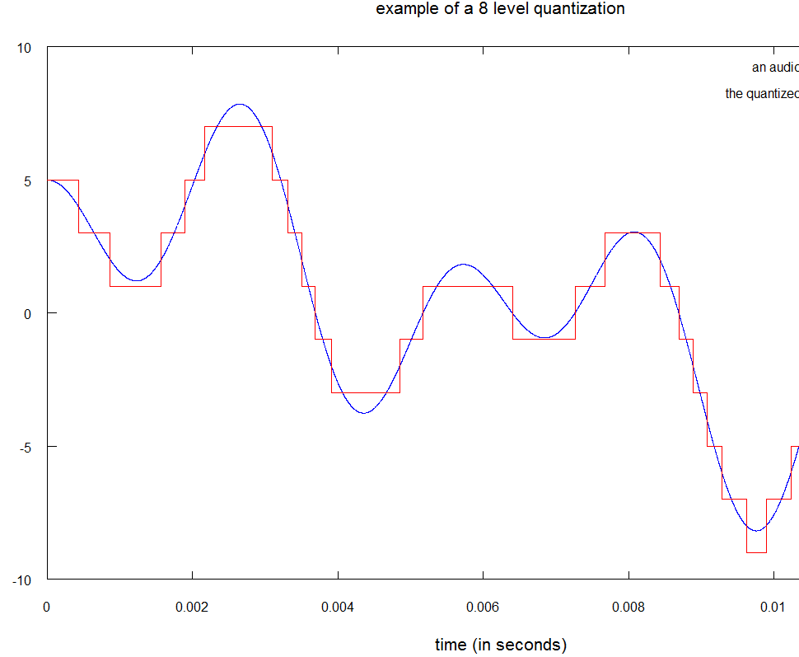
QUANTIZATION
This is an example of a low quantization, 8 level ( 3 bits) as stated.
AUDify uses the standard 16 bits (65536 level) quantization.

Slide 6
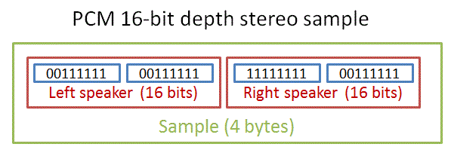
Pulse Code Modulation
PCM or Pulse Coded Modulation is a standard that represents digital signals. It is used by compact discs and most electronics devices.
Conversion of a multiple channel stream (stereo) is done to a single-channel stream (mono) by averaging the values from the left and right streams.

Slide 7
From digital sound to frequencies
Fingerprinting Algorithm works on signals in frequency domain.
2. Discrete time sound signals need to be converted into frequency domain.

Slide 8
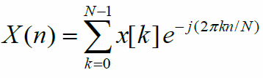
The Discrete Fourier Transform
N is the number of samples that composed the signal (size of the window)
X(n) represents the nth bin of frequencies
x(k) is kth sample of the audio signal
Applied to discrete time signals and gives a discrete frequency spectrum
A bin of frequencies is the smallest unit of frequency the DFT can compute
The size of the bin (called frequency resolution) equals the sampling rate of the signal divided by the size of the window (N)

Slide 9
Windowing
Windowing done to analyze the most necessary parts of the frequency signal by bifurcating into small parts
The signal audio(t) multiplied by a window function(t)
Produces spectral leakage(introduction of artificial frequencies in the audio signal)
Hamming window used which reduced spectral leakage and handled the noise

Slide 10
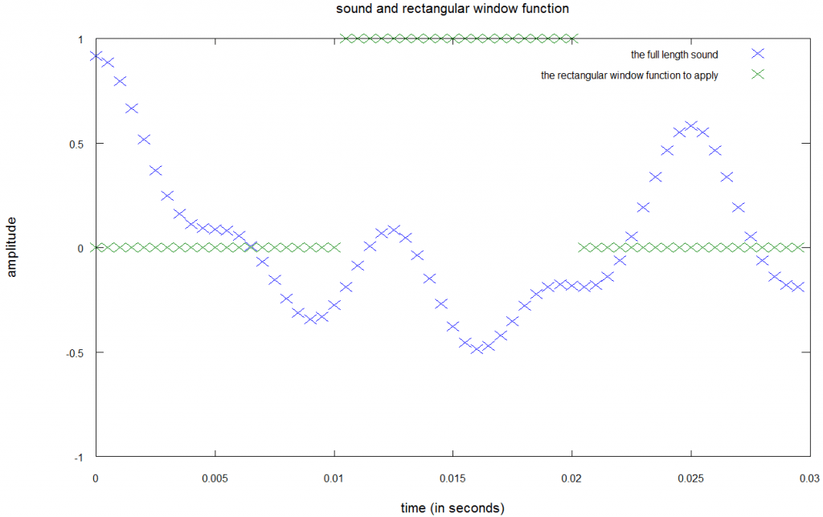

Slide 11
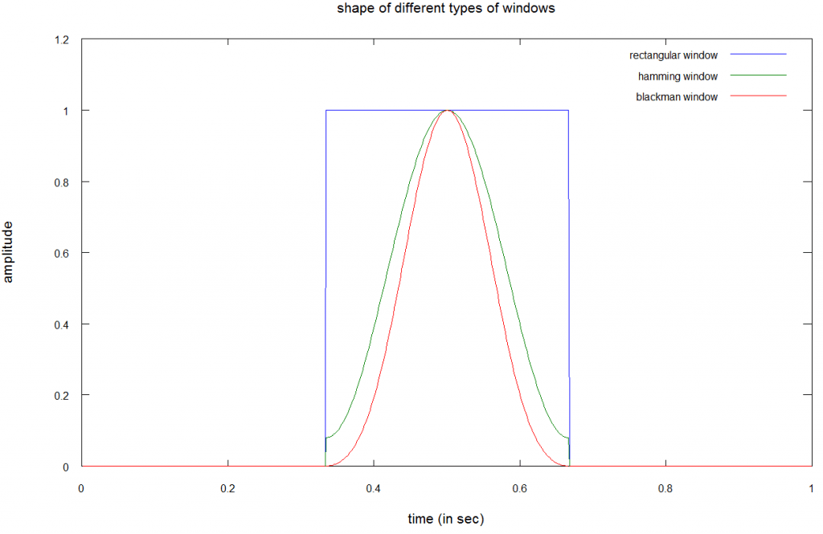
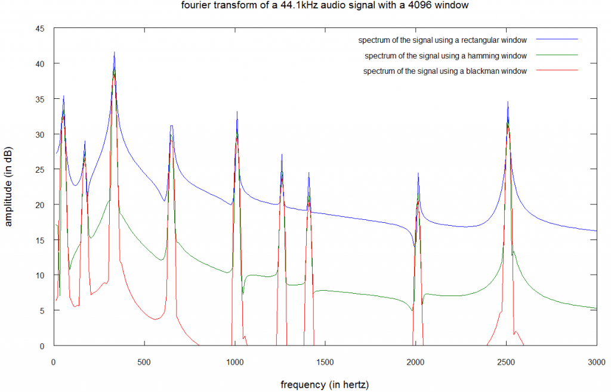

Slide 12
Fast Fourier Transform
DFT takes a lot of time.
FFT reduces time complexity from O(N^2) to O(N log N)
Uses the Cooley- Tukey algorithm which involves division of the N-sample window into two parts and then computing the FFT recursively for each
Resultant FFT is computed from the previous two FFTs.

Slide 13
Spectrogram filtering
The spectrogram from FFT is filtered to extract only strong frequencies in the spectrum which denote the loud notes.
For each FFT result, 512 bins are divided into 5 logarithmic bands.
For each band, the strongest bin of frequencies are kept.
Then, the average value of these 5 powerful bins is calculated.
Only the bins that are above this average value remain in the filtered spectrogram.

Slide 14
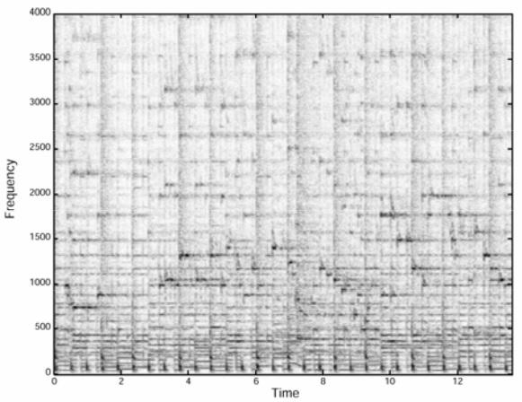
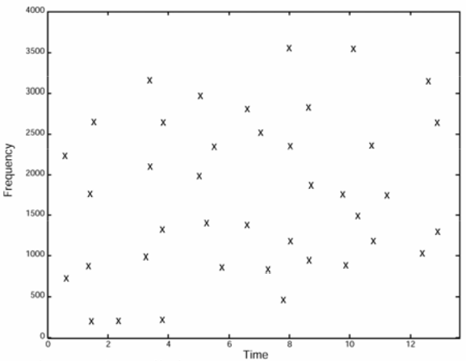
Filtered spectrogram

Slide 15
Storing Fingerprints
A database of filtered spectrograms for many songs is precomputed and stored
A short recording (minimum 2-3 seconds) of an unknown song is done and its filtered spectrogram is computed
This ‘small’ spectrogram is compared with the ‘full’ spectrogram of each song in the existing database by superposition
Time-consuming
So, we compare a set of points that are collectively termed as target zones.

Slide 16
Searching and scoring the fingerprints
The search is performed by generating an address structure during the fingerprinting of the recorded audio.
In order to create the addresses, we need to create an anchor point per target zone. The address is of the format: [“frequency of the anchor”;” frequency of the point”;” delta time between the anchor and the point”].
Each address from the record is used to search in the fingerprint database for the associated couples: [“absolute time of the anchor in the song”;” ID of the song”].
This search returns a large number of couples, let’s say N.

Slide 17
Result filtering and time coherency
For each address in the record, we get the associated value of the song and we compute delta = “absolute time of the anchor in the record” – “absolute time of the anchor in the song” and put the delta in a “list of delta”.
It is possible that the address in the record is associated with multiple values in the song (i.e. multiple points in different target zones of the song), in this case, we compute the delta for each associated values and we put the deltas in the “list of delta”.
For each different value of delta in the “list of delta” we count its number of occurrence (in other words, we count for each delta the number of notes that respect the rule “absolute time of the note in the song = absolute time of the note in record + delta”).
We keep the greatest value (which gives us the maximum number of notes that are time coherent between the record and the song).
From all the songs, we keep the song with the maximum time coherent notes. If this coherency is above (the number of note in the record)*( coefficient) then this song is the right one.

Slide 18
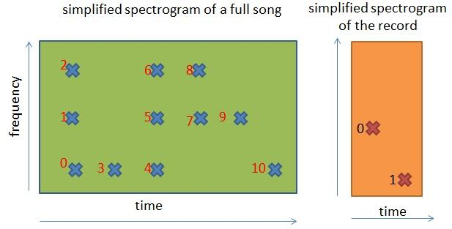
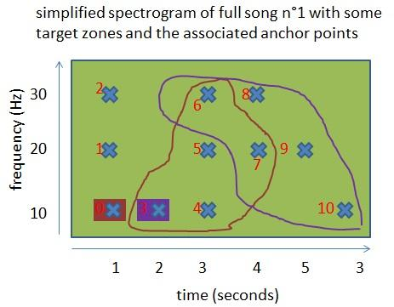
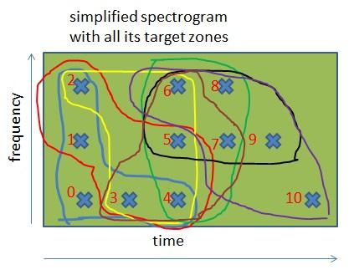

Slide 19
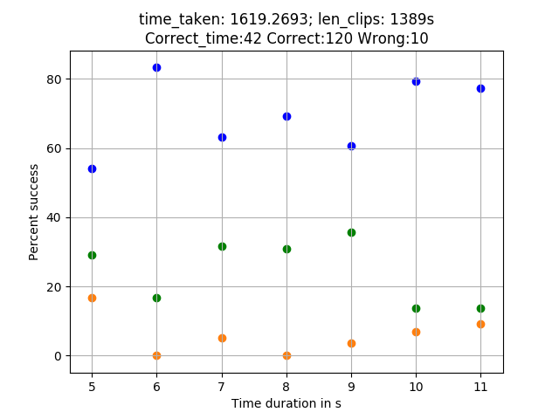
Result And Observation
The result computed is as follows:
Correct(blue) = Percentage of matches where the absolute difference in the time predicted by the algorithm and the time where the given song began in the actual song is not within the tolerance, but the fingerprint matches.
Correct_time(green) = Percentage of matches where the absolute difference in the time predicted by the algorithm and the time where the given song began in the actual song is within the tolerance, that is, 1 second, and also the fingerprint matches.
Wrong(orange)= Wrong matches
Therefore, 162 correct matches were found for 172 samples of random clips extracted from the database.

Slide 20
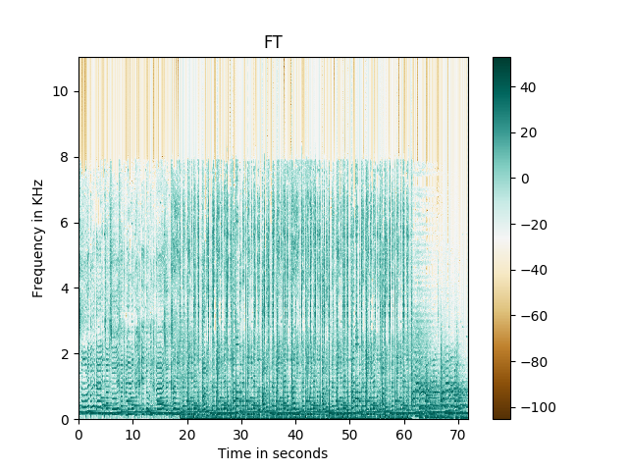
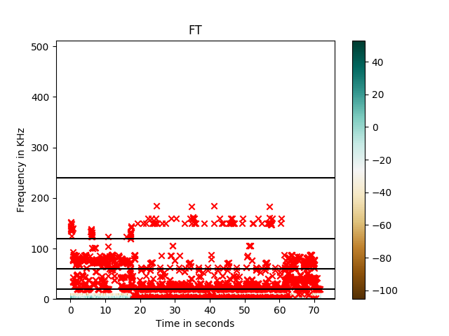
The spectrogram after DFT and the filtered spectrogram after spectrogram filtering for the song (Neovaii - I Remember) are:

Slide 21
Conclusion And Limitations
162 correct matches were found for 172 clips. Therefore, the accuracy of the algorithm is nearly 94.18 %.
The algorithm has the following limitations:
A clip of the original song should already be present in the database for identification. Songs cannot be identified by simply singing or humming them.
Since we have assumed the maximum frequency to be encountered in a song sample to be nearly 11000 kHz for faster results; in the worst possible scenario, if a frequency higher than that is encountered in the audio sample, it could lead to aliasing.
If we analyze parts of the song that have very weak frequencies( such as the end or beginning), we could end up with wrong values of strong frequencies( during spectrogram filtering), since the mean of these low frequencies would be very less.

Slide 22
FURTHER SCOPE
AUDify could have further enhancements and can be used for the detection of the genre of a song using a filtered spectrogram.
Moreover, this algorithm can be utilized to check for song plagiarism. Accuracy can be enhanced by using a better setup and sampling at 44100 Hz and time complexity can be reduced further by using downsampling.
Since human ears follow a psychoacoustic model, low sounds in a ‘raw’ song are artificially increased to make them perceptible to the human ear as compared to the shriller sounds.
Decreasing the frequencies of such low sounds would enable us to get the original ‘raw’ song and hence, enhance accuracy.

Slide 23
THANK YOU

